Slide 1

DEPARTMENT OF COMPUTER SCIENCE AND ENGINEERING
A Client-Side Hybrid AES–ECC Framework with Role-Based AccessControl for Secure Cloud File Sharing
BATCH ID : 23MPCS-G13
S. No | Roll. No | Student Name
1 | 23881A05DB | Kethavath Ashwitha
2 | 23881A05DR | Mohammed Musthabeen Ahmad
3 | 23881A05CJ | Burra Nandini Goud
Guide Details
Mr. Muralidhar Morya
Assistant professor
Department of CSE

Slide 2
Mini Project Outlines
Introduction
Existing System Vs Proposed
Research Gaps
Problem Statement
Proposed Project Objectives
Proposed Project Outcomes
Software and Hardware Requirements
Architectural Diagram
Proposed Methods and Algorithms
Results
Research Paper (Acceptance Proofs)
Conclusion

Slide 3
Introduction
Cloud computing has revolutionized data storage and access by providing scalable and cost-effective solutions.
However, it raises serious concerns about data security, privacy, and unauthorized access.
This project focuses on developing a Secure Cloud File Sharing System.
It uses client-side encryption to protect data before uploading to the cloud.
Technologies like AES, ECC, and Role-Based Access Control (RBAC) are used to enhance security.
The goal is to ensure data confidentiality, secure access, and user control over cloud-stored data.

Slide 4
Existing System Vs Proposed
Existing System | Proposed System
Server-side encryption | Client-side encryption
Cloud provider controls data | User controls data
Risk of data leakage | High security
Weak access control | RBAC implemented
No key protection | AES + ECC used
DEPARTMENT OF CSE : MINI PROJECT

Slide 5
Research Gaps
Most cloud systems rely on server-side security, reducing user control.
Lack of client-side encryption exposes sensitive data to cloud providers.
Key management is complex and difficult to handle efficiently.
Existing systems may have high computational overhead.
Weak or limited access control mechanisms increase security risks.
Use of static encryption keys makes systems vulnerable if compromised.
Many solutions do not fully protect against insider threats.
DEPARTMENT OF CSE : MINI PROJECT

Slide 6
Problem Statement
Cloud storage systems lack sufficient security due to reliance on server-side encryption, leading to risks like data breaches, unauthorized access, poor key management, and limited user control over data.
DEPARTMENT OF CSE : MINI PROJECT

Slide 7
Proposed Project Objectives
To develop a secure cloud file sharing system
To implement client-side encryption for data protection
To use AES algorithm for securing data
To apply ECC for secure key exchange
To design Role-Based Access Control (RBAC)
To prevent unauthorized access and data breaches
To ensure efficient performance and scalability
Short Version (Single Line)
To design a secure cloud storage system using client-side encryption, AES, ECC, and RBAC to ensure data confidentiality and controlled access.
DEPARTMENT OF CSE : MINI PROJECT

Slide 8
Proposed Project Outcomes
Secure cloud storage system with enhanced data protection
Successful implementation of client-side encryption
Improved data confidentiality and privacy
Efficient key management using ECC
Controlled access using RBAC mechanism
Reduced risk of unauthorized access and data breaches
Reliable and user-friendly system performance
Short Version (Single Line)
A secure and efficient cloud file sharing system that ensures data confidentiality, controlled access, and protection against security thr
DEPARTMENT OF CSE : MINI PROJECT

Slide 9
Software and Hardware Requirements
Software Requirements
Operating System: Windows / Linux / macOS
Programming Language: Python
Frontend: React.js
Backend: Firebase Authentication
Database: MySQL / SQLite
Cloud Platform: AWS / Google Cloud
Libraries: Cryptography libraries
Hardware Requirements
Processor: Intel i3 or higher
RAM: Minimum 4 GB
Storage: 500 GB Hard Disk
System Type: 64-bit
Internet Connection
DEPARTMENT OF CSE : MINI PROJECT

Slide 10
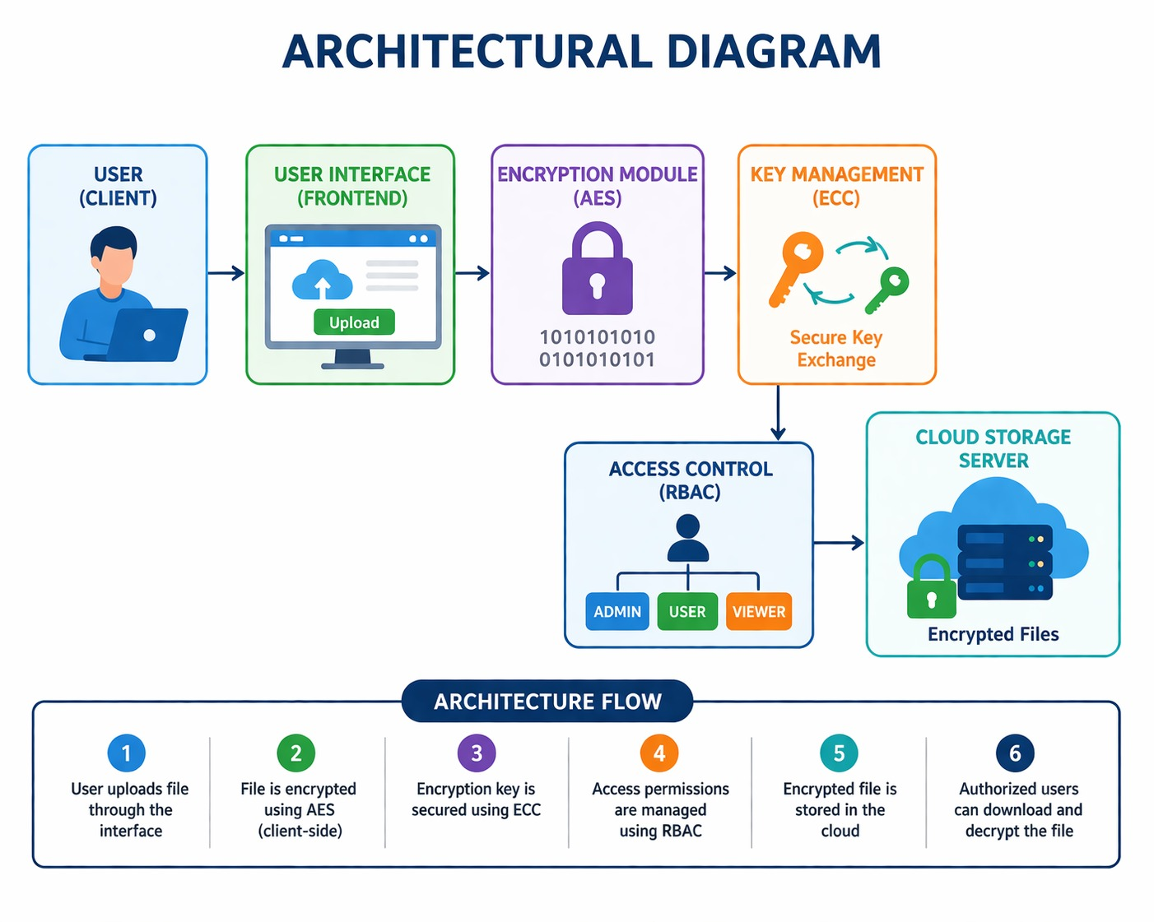
Architectural Diagram
DEPARTMENT OF CSE : MINI PROJECT

Slide 11
PROPOSED METHOD AND ALGORITHMS
Client-Side Encryption: Data is encrypted on the user’s device before uploading, preventing exposure to cloud providers.
Hybrid Cryptography: Combines AES for fast symmetric encryption of files and ECC for secure key exchange.
Encryption: File → AES → Ciphertext; AES key → ECC → Encrypted key
Decryption: ECC decrypts AES key → AES decrypts file
Role-Based Access Control (RBAC): User roles (Admin, User, Viewer) determine access permissions.
Multi-Factor Authentication (MFA): Adds OTP or verification for identity validation.
Secure Key Management: Keys are securely generated, stored, and exchanged to prevent misuse.
DEPARTMENT OF CSE : MINI PROJECT
DEPARTMENT OF CSE : MINI PROJECT

Slide 12
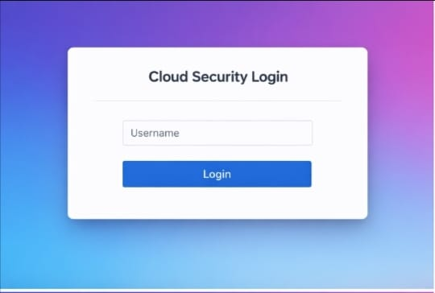
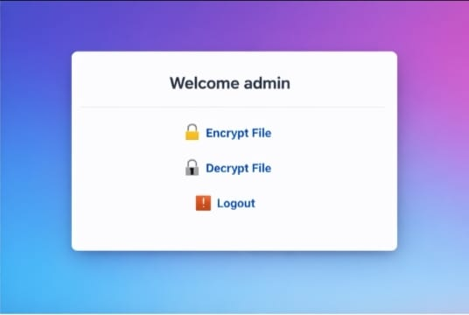
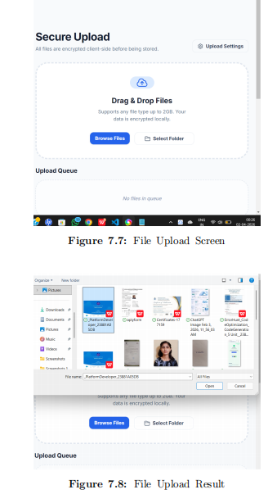
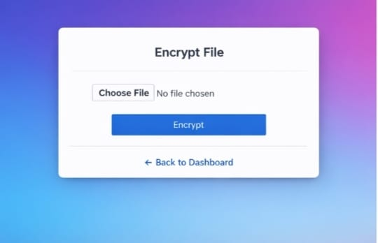
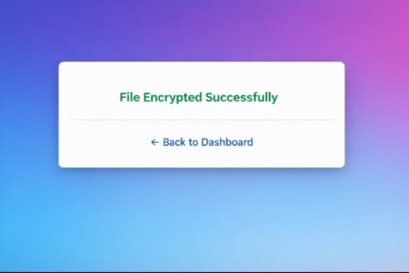
Results
DEPARTMENT OF CSE : MINI PROJECT

Slide 13
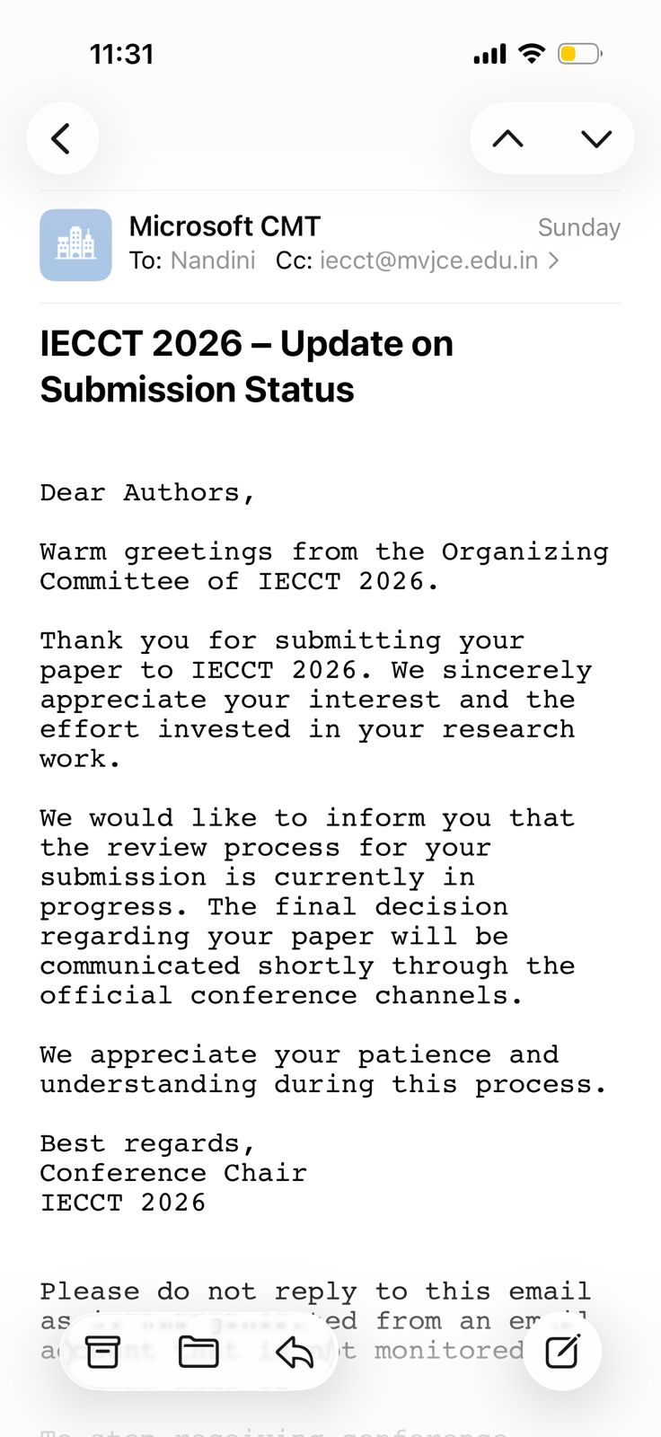
Research Paper (Acceptance Proof)
DEPARTMENT OF CSE : MINI PROJECT
DEPARTMENT OF CSE : MINI PROJECT

Slide 14
Conclusion
The system ensures secure cloud file sharing by encrypting data client-side and using AES with ECC for efficient, strong protection. RBAC and MFA enhance access control and user verification, providing a reliable, scalable, and secure solution for cloud data management.
Data Integrity: Ensures that files are protected from tampering during storage and transmission.
User Privacy: Sensitive user data remains confidential, even from the cloud service provider.
DEPARTMENT OF CSE : MINI PROJECT

Slide 15
Thank You
DEPARTMENT OF CSE : MINI PROJECT

